Slide 1
Phase2-OS
By-Varsha R.Dange

Slide 2
Error Types
SI → supervisor Interrupt SI = 1 on GD
= 2 on PD
= 3 on H
TI → Timer Interrupt TI = 2 on Time Limit Exceeded
PI →Program Interrupt
PI = 1 Operation Error
= 2 Operand Error
= 3 Page Fault

Slide 3
ERROR Message coding
Error | EM ( Error Message or Error code)
NO Error | 0
Out of Data | 1
Line Limit Exceeded | 2
Time Limit Exceeded | 3
OpCode Error | 4
Operand Error | 5
Invalid Page Fault | 6
Time Limit Exceeded With Opcode Error | 7 = (3+4)
Time Limit Exceeded With operand Error | 8 = (4+4)

Slide 4
NO Error
$AMJ 0001 0005 0002 //control card
GD10 GD20 PD10 PD20 H //program card
$DTA //data card
How are you?
I am Fine
$END0001

Slide 5
OpCode Error
$AMJ 0001 0003 0002
GD10 LD20 PD10 PD20 H //program card
$DTA
How are you? //data card
I am Fine
$END0001 Here , Interrupt PI=1

Slide 6
Operand Error
$AMJ 0001 0003 0002
GD10 GD20 PDLO PD20 H //program card
$DTA
How are you? //data card
I am Fine
$END0001
Here , Interrupt PI=2

Slide 7
Page Fault Error
$AMJ 0001 0006 0002
GD10 GD20 PD10 PD20 LR30 H //program card
$DTA
How are you? //data card
I am Fine
$END0001
Here , Interrupt PI=3

Slide 8
Page Fault Error
Page fault
Valid Page fault
Invalid Page fault
Valid Page fault:
When we are using GD ,SR then we have valid page fault
Invalid Page fault:
When we are using PD,LR ,CR then we have invalid page fault
When we are having any interrupt we have to terminate the program

Slide 9
Time Limit Exceeded Error
$AMJ 0001 0003 0002
GD10 GD20 PD10 PD20 H //program card
$DTA
How are you? //data card
I am Fine
$END0001
Here , Interrupt TI=2

Slide 10
Out of Data Error
$AMJ 0001 0005 0002
GD10 GD20 PD10 PD20 H //program card
$DTA
$END0001

Slide 11
Line Limit Exceeded Error
$AMJ 0001 0003 0001
GD10 GD20 PD10 PD20 H //program card
$DTA
How are you? //data card
I am Fine
$END0001

Slide 12
Time Limit Exceeded with Opcode Error
$AMJ 0001 0003 0002
GD10 GD20 PD10 LD20 H //program card
$DTA
How are you? //data card
I am Fine
$END0001
Here , Interrupt TI=2 and PI=1

Slide 13
Time Limit Exceeded with Operand Error
$AMJ 0001 0003 0002
GD10 GD20 PD10 PDLO H //program card
$DTA
How are you? //data card
I am Fine
$END0001
Here , Interrupt TI=2 and PI=2

Slide 14
ASSUMPTIONS:
Jobs may have program errors
PI interrupt for program errors introduced
No physical separation between jobs
Job outputs separated in output file by 2 blank lines
Paging introduced, page table stored in real memory

Slide 15
6. Program pages allocated one of 30 memory block using random number generator:
In phase 2 ,we assumed size of main memory as 300 words. (300 X 4 size)
000
4 Bytes
1word
001
002
003
0th block
004
005
006
007
1 block = 10 words
008
009
|
|
|
|
|
|
290
10th block
|
299
Main Memory

Slide 16
ASSUMPTIONS:
Load and run one program at a time
Time limit, line limit, out-of-data errors introduced
TI interrupt for time-out error introduced
2-line messages printed at termination :

Slide 17
ASSUMPTIONS:
10. 2-line messages printed at termination :
$AMJ 0001 0003 0001
GD10 PD10 H
$DTA
$END0001
Output file :
Input IC IR TTL TLL TTC LLC
0001 01 GD10 3 1 0 0
Input: For which Job error is there
IC: (Instruction counter) for which instruction error is there
IR: (Instruction register) content of Register
TTL: Total Time Limit
TLL: Total Line Limit
TTC → Total Time counter → No single instruction executed so TTC= 0
LLC → Line Limit counter → No single line printed executed so LLC= 0

Slide 18
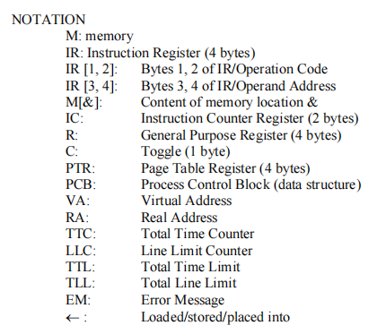
Notations
Opcode: GD PD
LR
SR CR
BT
H

Slide 19
MOS : Interrupt get handle by MOS
In phase 1 we have written switch case for SI SI=1 read(),SI=2: write() and SI=3: terminate()
In Phase 2 we have combinations of Interrupts
Case1: TI & SI→
TI | SI |  | Action
0 | 1 | GD | Read
0 | 2 | PD | write
0 | 3 | H | Terminate (0)
2 | 1 | GD | Terminate (3)
2 | 2 | PD | Write then Terminate (3)
2 | 3 | H | Terminate (3)
Time Limit Not exceeded
Time Limit exceeded

Slide 20
MOS : Interrupt get handle by MOS
Case 2: TI & PI→
TI | PI |  | Action
0 | 1 | Opcode | Terminate (4)
0 | 2 | Operand | Terminate (5)
0 | 3 | Page fault: GD & SR- valid PD,LR,CR- invalid | If Page Fault Valid, ALLOCATE, update page Table, Adjust IC if necessary , EXECUTE USER PROGRAM Otherwise Terminate (6)
2 | 1 | Opcode | Terminate (3,4)
2 | 2 | Operand | Terminate (3,5)
2 | 3 | Page fault | Terminate (3)
Time Limit Not exceeded
Time Limit exceeded

Slide 21
MOS : Interrupt get handle by MOS
Can not have combination of SI & PI→ ?
Because in both same numbering is used SI={1,2,3}
PI ={1,2,3}, So combination not possible
Same as phase 1 , in phase 2 ,we are having read(),write() and terminate ().
But here Terminate () is overloaded.. (one function can have many form)
It takes single argument or two arguments
Here arguments means Error messages(EM-0 to 8)
Terminate(7) or Terminate(3,4)
Terminate(8) or Terminate(3,5)

Slide 22
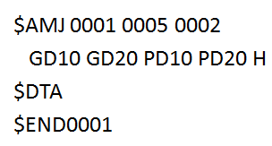
Read() ,Write() & Terminate()
Read()
If next data card is $END, TERMINATE (1)
Read next (data) card from input file in memory locations RA through RA + 9
EXECUTEUSERPROGRAM
After $DTA , if $END comes, it means no data is there ,OUT OF DATA Error, then call Terminate (0).
Otherwise Read from memory location RA to RA+9 (1 block) and call EXECUTEUSERPROGRA()

Slide 23
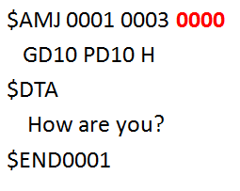
Read() ,Write() & Terminate()
Write()
LLC = LLC + 1
If LLC > TLL, TERMINATE (2)
Write one block of memory from locations
RA through RA + 9 to output file
EXECUTEUSERPROGRAM
Write()
LLC = LLC + 1
If LLC > TLL, TERMINATE (2)
Write one block of memory from locations
RA through RA + 9 to output file
EXECUTEUSERPROGRAM
LLC is Line Limit Counter ,an int variable ,used to keep track of total no. of printed output lines in a job.
When GD instruction comes, it increment LLC by 1: LLC = LLC + 1
It will check LLC > TLL ,if it is then Terminate(2): Line Limit Exceed
Otherwise , read contents from main memory from RA to RA+9 and placed in to output file . And call EXECUTEUSERPROGRAM()

Slide 24

Read() ,Write() & Terminate()
TERMINATE (EM)
Write 2 blank lines in output file
Write 2 lines of appropriate Terminating Message as indicated by EM
LOAD
With Terminate() ,2 line get added in output file & 2lines of error message also and then call Load().

Slide 25
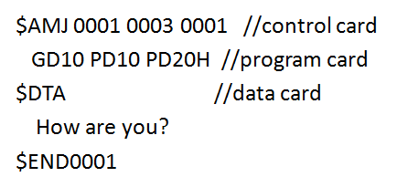
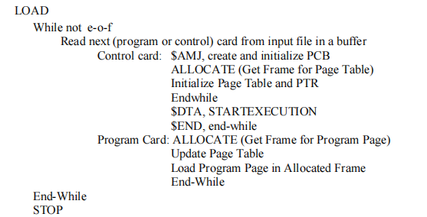
Load()
We have to read the contents till EOF .
When we have input file ,it contains multiple jobs .
Read program card from input file into the buffer to check whether it is control card ($AMJ) ,program card , data card($DTA ) or $END .
If it $AMJ then create and initialize PCB(Process control Block).
PCB is a structure that store information of given job

Slide 26
PCB
PCB is a structure that store information of given job.
It having 3 variables:
int JID → Job ID
int TTL → Total Time Limit
int TLL → Total Line Limit
Assign this as- P1 is above structure here
P1.JID = 0001
P1.TTL = 0003
P1.TLL = 0001

Slide 27
ALLOCATE()
Then we have to call ALLOCATE()
Example with allocate () ,we have generate a random no. as 14
ALLOCATE()
Generate one no. randomly between 0 to 29
Store that in an array

Slide 28
Initialize Page Table and PTR
0
000
1 block = 10 locations
14 * 10 =140 → Base Address ,
PTR : a variable , store base address of page table
140 to 149 location initialize with 0 and 3rd & 4th column with symbol or a negative value (-1).
140
PTR
0
*
*
0
*
*
|
|
|
|
|
|
14 B
l o c
k
0
*
*
0
*
*
0
*
*
Page Table
0
*
*
0
*
*
0
*
*
0
*
*
149
0
*
*
29
299

Slide 29
Continued…… Load()
0
000
If it is Program card the call ALLOCATE() again.
It generate random no.
Update the page table
Suppose random no. = 17 ,so enter it at base address of page table i.e. at 3rd & 4th column.
Load the program in page in allocate frame .
Till we get $DTA, it will load program card in to memory
If next number as 26 ,then enter it at 141 ,set the flag to 1 etc.
If $DTA comes then call STARTEXECUTION() .
It means program saved in main memory and then start execution.
PTR
140
1
1
7
0
*
*
|
|
|
|
|
|
14 B
l o c
k
0
*
*
0
*
*
Page Table
0
*
*
0
*
*
0
*
*
0
*
*
0
*
*
149
0
*
*
|
GD10
170
17
PD10
|
H
179
29
299

Slide 30
Continued…… Load()
STARTEXECUTION
IC ← 00
EXECUTEUSERPROGRAM
END (MOS)
Initialize IC=0 and call EXECUTEUSERPROGRAM()

Slide 31
EXECUTEUSERPROGRAM()
Use of this Function to fetch the instructions from main memory to IR and Increment IC by 1.
Then check contents of IR ,whether it is GD,PD,SR,LR,CR,BT ,H or raise interrupt.

Slide 32
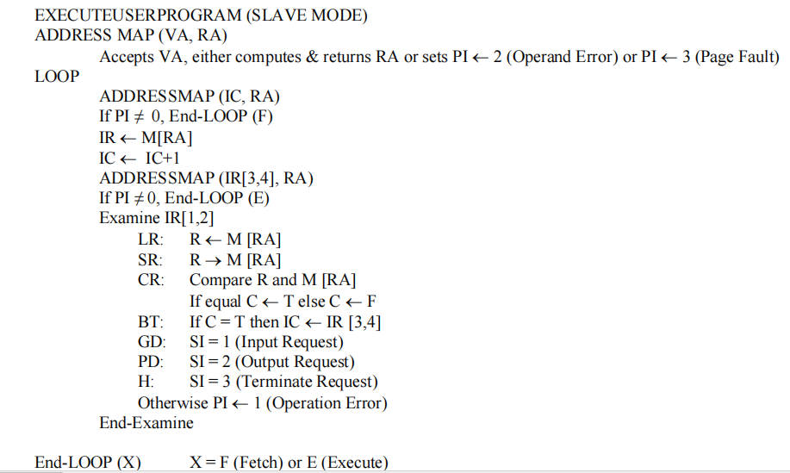
EXECUTEUSERPROGRAM()

Slide 33
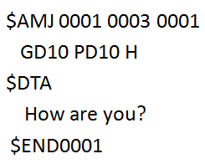
EXECUTEUSERPROGRAM()
before fetching instruction, here we call ADDRESSMAP().
It takes arguments as IC and return RA.
VA- virtual Address (00 to 99)
RA-real address(0 to 299)
In GD10,10 is VA, we need to convert it into RA.
SO we use ADDRESSMAP().
Why we pass IC as an argument?
In phase 1,program card stored at 0th memory location.
But in phase 2 , program card can store at any random location
So we have to get exact memory location by mapping

Slide 34
EXECUTEUSERPROGRAM()
In IT ,we get location of 1st instruction and increment IC by 1 .
IR→
Pass 10 to ADDRESSMAP(), get the RA for 10.
For this we examine 1st two byes of IR ,is it GD ,PD or what?
If OpCode is not correct then raise PI =1 ,OpCode error,
G
D
1
0

Slide 35
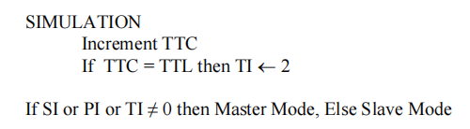
SIMULATION()
Using SIMULATION(), we will also check Time limit exceed or not
Here, TTC initialize to 0.
If any of the instruction
get executed successfully TTC incremented by 1.
Then Check for TTC & TTL ,if TTC > TTL then it will raise Time interrupt TI =2.
Whenever values of SI or PI or TI is non zero means interrupt is there and have to call MOS().

Slide 36
ADDRESSMAP()
ADDRESSMAP( VA or IC ){
if (VA is a number)
{
FrameNo = M[PTR][2] * 10 + M[PTR][3];
if(FrameNo = **) then
PI=3 →page fault
else
RA = FrameNo *10 + VA/10
return RA
}
else
PI = 2 →operand error
}

Slide 37
ADDRESSMAP()
0
000
It takes VA or IC as argument and return RA.
Here IC is a number ,i.e. operand
If VA is number then further calculations
Else generate operand error ,PI=2
Now VA is number..
If it is * then we haven't assign any frame no ,so it is page fault.
FrameNo = M[PTR][2] * 10 + M[PTR][3]
FrameNo= 1*10+7 =17
NOW RA for 1st instruction: RA= FrameNo *10 + VA/10 …mod
RA = 17 *10 + 0/10 =170
So instructions are stored at Frame no 17 i.e. from 170 to 179
0th
1st
2nd
3rd
PTR
140
1
1
7
0
*
*
|
|
|
|
|
|
14 B
l o c
k
0
*
*
0
*
*
Page Table
0
*
*
0
*
*
0
*
*
0
*
*
0
*
*
149
0
*
*
|
GD10
170
17
PD10
|
H
179
29
299

